Slide 1
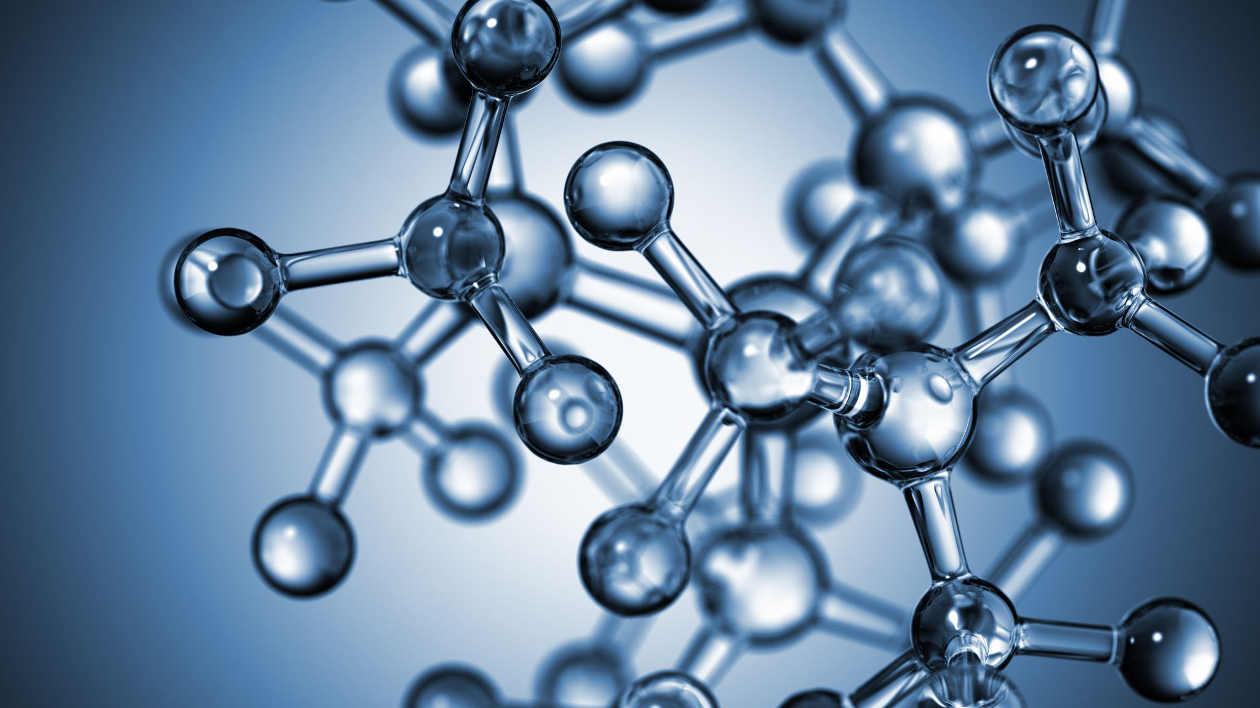


Oxidative-reduction reactions. Method of construction of oxidation-reduction reactions and their balancing.
Al-Farabi Kazakh National University
Faculty of Chemistry and Chemical technology
Department of General and Inorganic Chemistry
pHd Bakhadur askar

Slide 2
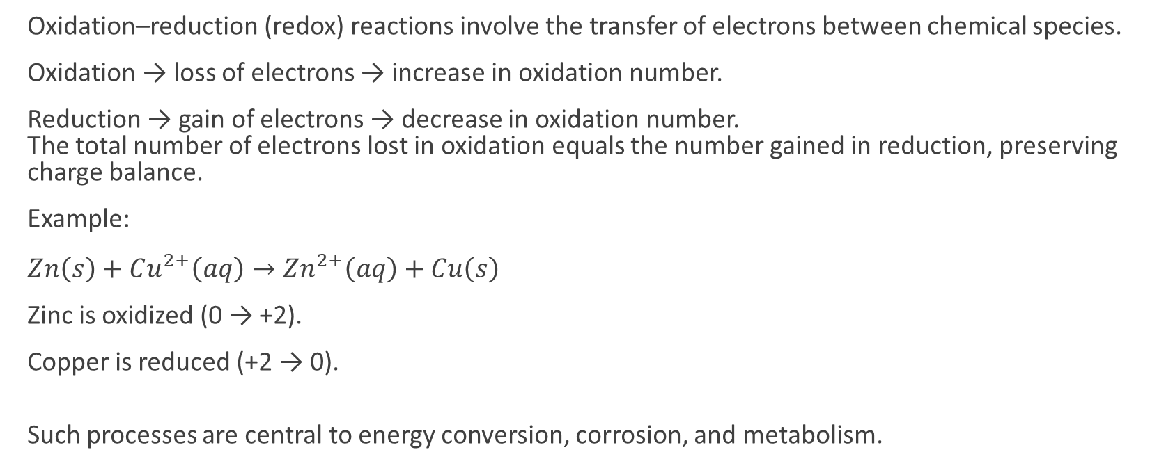
The nature of oxidation–reduction reactions
Oxidation–reduction (redox) reactions involve the transfer of electrons between chemical species.
Oxidation → loss of electrons → increase in oxidation number.
Reduction → gain of electrons → decrease in oxidation number. The total number of electrons lost in oxidation equals the number gained in reduction, preserving charge balance.
Example:
$Zn\left(s\right)+Cu^{2+}\left(aq\right)→Zn^{2+}\left(aq\right)+Cu\left(s\right)$
Zinc is oxidized (0 → +2).
Copper is reduced (+2 → 0).
Such processes are central to energy conversion, corrosion, and metabolism.

Slide 3
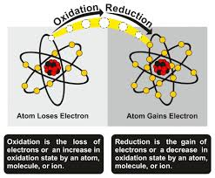

Oxidation numbers and electron accounting
Oxidation number (ON) is a bookkeeping device that helps track electron transfer. Rules for assigning oxidation numbers:
Free elements → ON = 0.
Monoatomic ions → ON = ionic charge.
Oxygen usually = –2, hydrogen = +1.
Sum of ONs = total charge of compound or ion.
Example:
$Cr_{2}O_{7}^{2−}$
Let Cr = x
$2x+7\left(−2\right)=−2⇒x=+6$
Thus, Cr changes from +6 to +3 when reduced — gaining 3 electrons per atom.

Slide 4
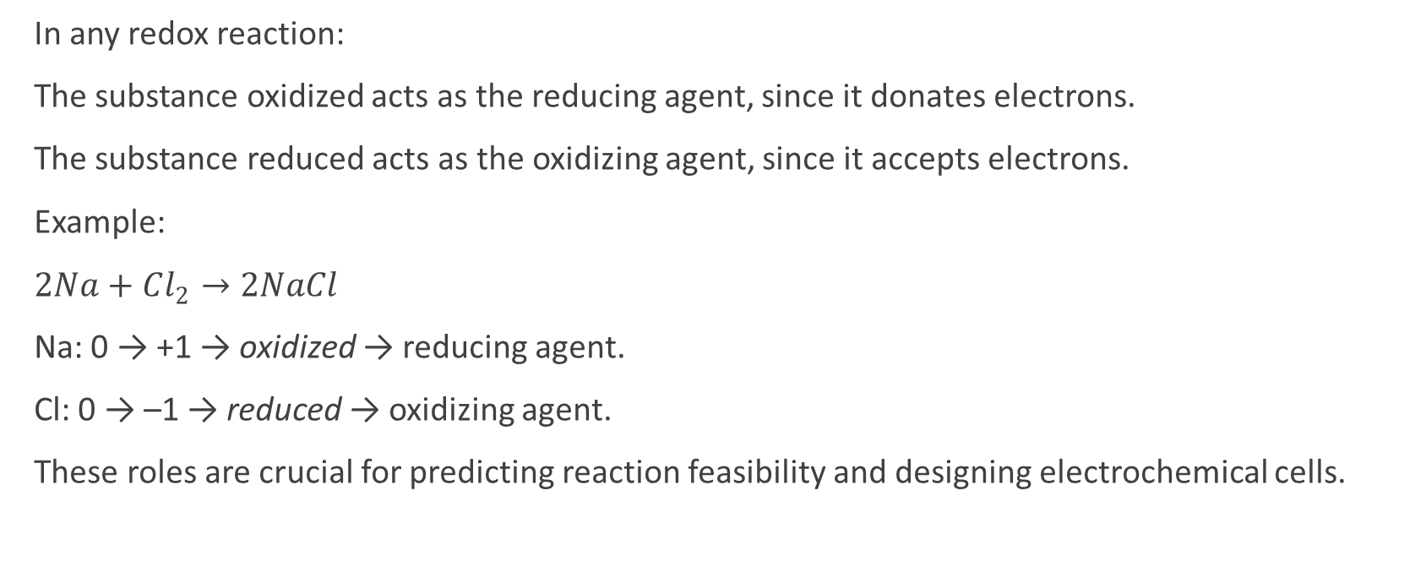
Identifying oxidizing and reducing agents
In any redox reaction:
The substance oxidized acts as the reducing agent, since it donates electrons.
The substance reduced acts as the oxidizing agent, since it accepts electrons.
Example:
$2Na+Cl_{2}→2NaCl$
Na: 0 → +1 → oxidized → reducing agent.
Cl: 0 → –1 → reduced → oxidizing agent.
These roles are crucial for predicting reaction feasibility and designing electrochemical cells.

Slide 5
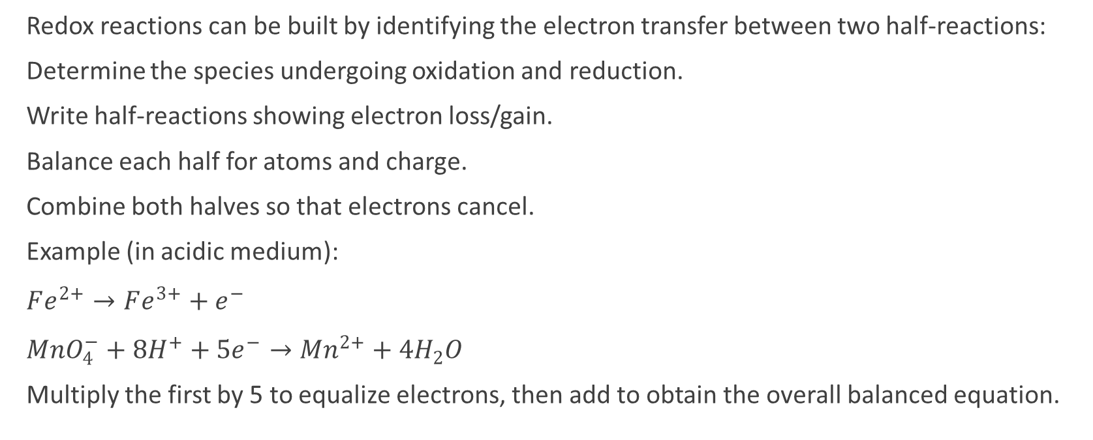
Construction of redox reactions
Redox reactions can be built by identifying the electron transfer between two half-reactions:
Determine the species undergoing oxidation and reduction.
Write half-reactions showing electron loss/gain.
Balance each half for atoms and charge.
Combine both halves so that electrons cancel.
Example (in acidic medium):
$Fe^{2+}→Fe^{3+}+e^{−}$
$MnO_{4}^{−}+8H^{+}+5e^{−}→Mn^{2+}+4H_{2}O$
Multiply the first by 5 to equalize electrons, then add to obtain the overall balanced equation.

Slide 6
Half-reaction balancing method
Steps in Acidic Medium:
Separate oxidation and reduction halves.
Balance all atoms except O and H.
Balance oxygen using H₂O.
Balance hydrogen using H⁺.
Balance charge with electrons.
Combine and simplify.
Steps in Basic Medium:
After balancing as if acidic, add OH⁻ to both sides to neutralize H⁺ and form H₂O.
Simplify water molecules.
This systematic method ensures mass and charge conservation and is widely used in analytical chemistry and electrochemistry.

Slide 7
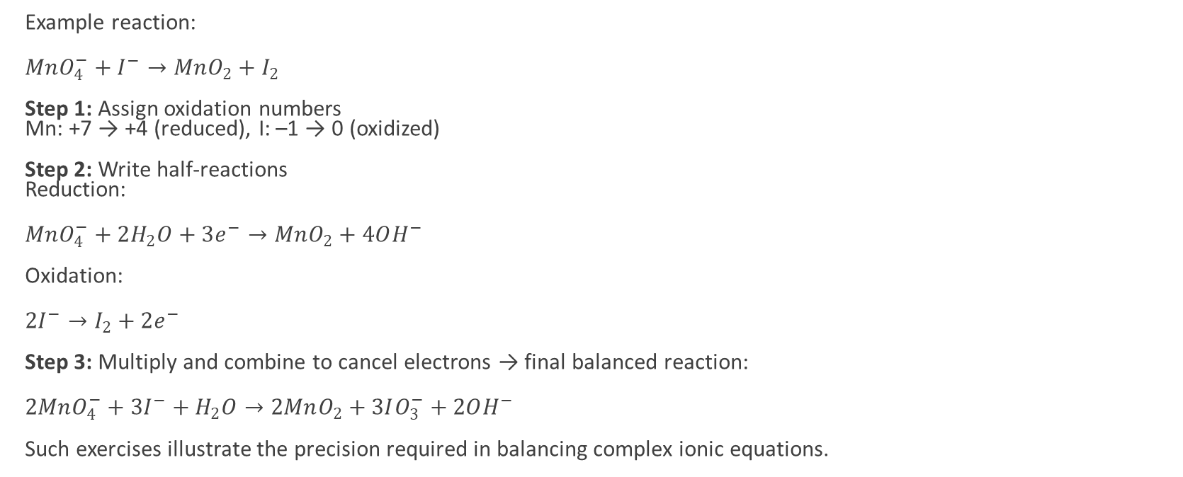
Balancing in basic medium
Example reaction:
$MnO_{4}^{−}+I^{−}→MnO_{2}+I_{2}$
Step 1: Assign oxidation numbers Mn: +7 → +4 (reduced), I: –1 → 0 (oxidized)
Step 2: Write half-reactions Reduction:
$MnO_{4}^{−}+2H_{2}O+3e^{−}→MnO_{2}+4OH^{−}$
Oxidation:
$2I^{−}→I_{2}+2e^{−}$
Step 3: Multiply and combine to cancel electrons → final balanced reaction:
$2MnO_{4}^{−}+3I^{−}+H_{2}O→2MnO_{2}+3IO_{3}^{−}+2OH^{−}$
Such exercises illustrate the precision required in balancing complex ionic equations.

Slide 8
Applications of redox reactions
Redox processes are central to many chemical, biological, and industrial systems:
Metallurgy: Extraction of metals from ores (e.g., Fe from Fe₂O₃).
Energy production: Batteries, fuel cells, and corrosion control.
Biochemistry: Cellular respiration and photosynthesis involve redox chains.
Environmental chemistry: Oxidation of pollutants and reduction in wastewater treatment.
Analytical chemistry: Redox titrations (e.g., permanganate and dichromate methods).
Understanding oxidation–reduction principles allows chemists to control energy flow and material transformations.

Slide 9
Summary
Redox reactions involve electron transfer, resulting in changes in oxidation states.
The half-reaction method is the most systematic way to balance redox equations.
Oxidizing agents accept electrons; reducing agents donate them.
Accurate balancing requires attention to mass, charge, and medium (acidic/basic).
Redox principles underpin electrochemistry, metabolism, and industrial synthesis.
Oxidation–reduction chemistry connects the microscopic flow of electrons to macroscopic energy transformations. Mastering the construction and balancing of redox reactions enables prediction and control of chemical processes essential to technology, biology, and the environment.

Slide 10

Questions?

